Slide 1


CTEIS Updates
Douglas Wiesner, Ph. D.
PTD Technology

Slide 2
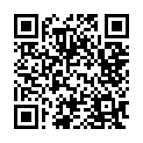
Doug Wiesner, Ph.D.
PTD Technology
This slide deck will be available on SUPPORT.CTEIS.com shortly

Slide 3
What’s New with CTEIS?
Manage Credentials
  List of all State-Approved CTE Credentials
  Updated Manage Credentials entry page
  Review of Credential reports
Manage Work-Based Learning
  Review of WBL reports
2023 CTEIS Updates
  Enrollments
    Manage Enrollments Update
    Minimal Import Update
    Mange Students Update
      Migrant Students
    CEPD Admin Building Enrollment Report
    Class List Report
  Expenditures
    X0207 Report
Upcoming Dates

Slide 4
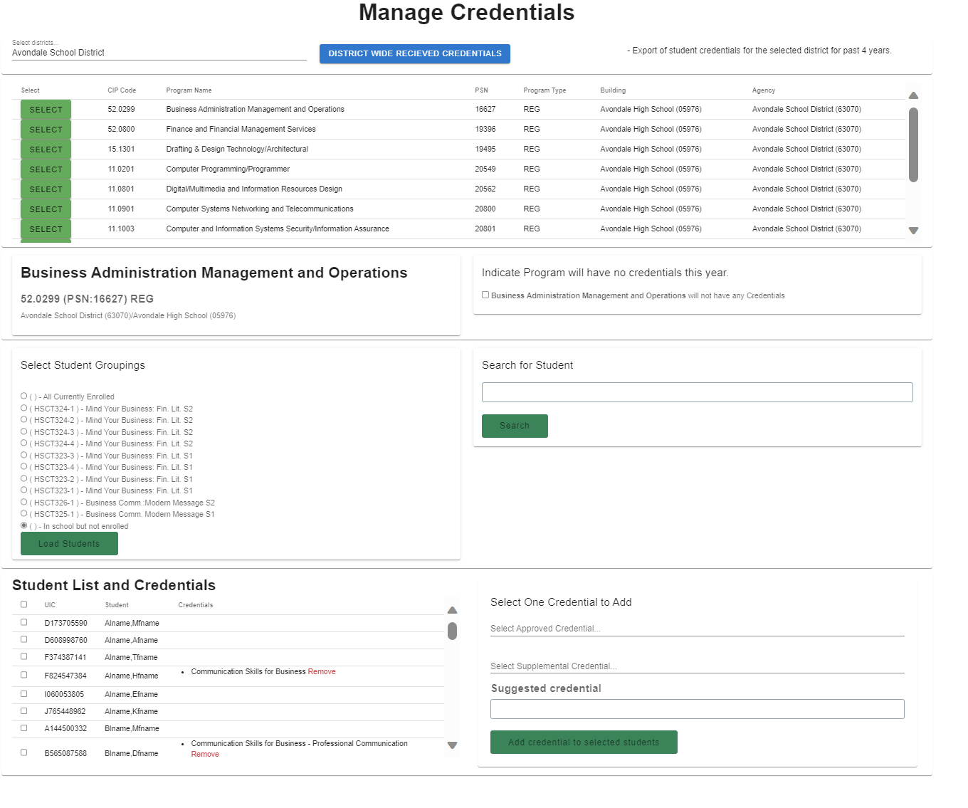
Updated Manage Credentials
Manage Credentials
  Update District Manage Credentials
  Faster, easier to use
  Works generally the exact same

Slide 5
Credential Reporting
Manage Credentials
Public Reports – (Reports.CTEIS.com)
  List of All State-Approved CTE Credentials -NEW
  Approved CTE Credentials Offered by Districts
  Michigan School CTE Program Credentials
District CTEIS Reports (CTEIS.com)
  Credentials by PSN

Slide 6
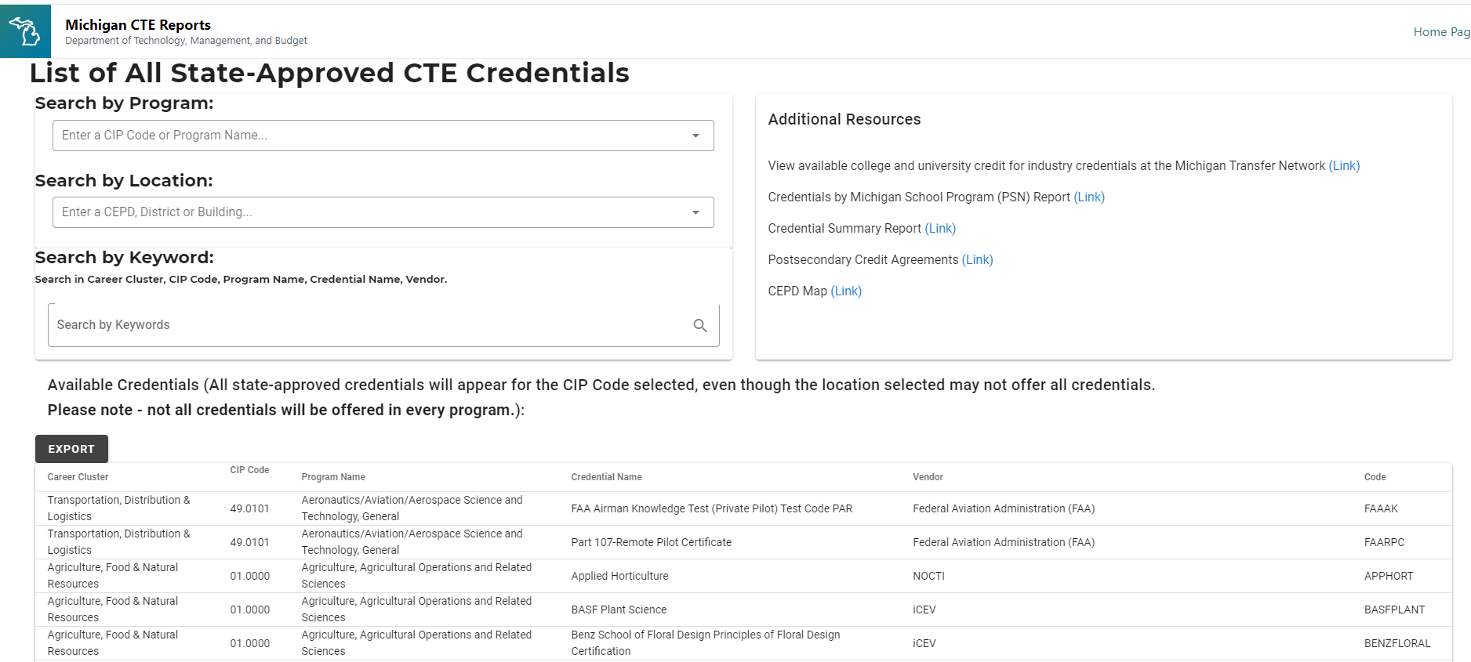
List of All State-Approved CTE Credentials
Manage Credentials
List of all available credentials
Searchable, sortable, exportable
Lists all Credential Codes required for imports

Slide 7
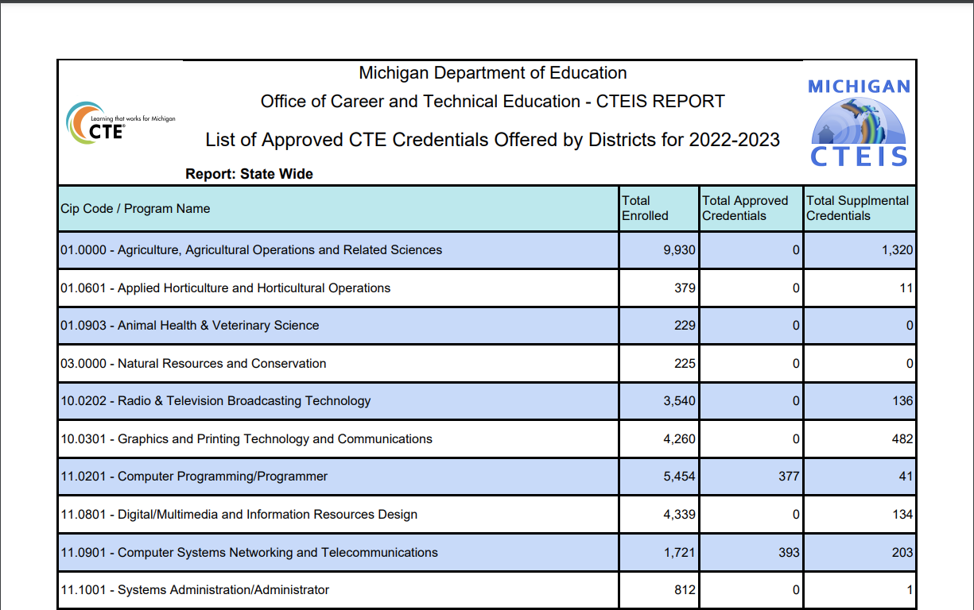
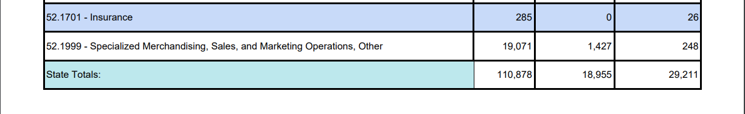
Approved CTE Credentials Offered by Districts
Manage Credentials
REPORTS.CTEIS.COM
Available
  Statewide
  CEPD
  FA
  Building
  CIP Code
  Fed Cluster
  Region
List of all Approved, Supplemental and Suggested Credentials by Entity.

Slide 8

Michigan School CTE Program Credentials
Manage Credentials
REPORTS.CTEIS.COM
Available by
  Fiscal Agency
  Building
  CIP Code
  Fed Cluster
By Year
List all programs in a building and what credentials have been granted.

Slide 9
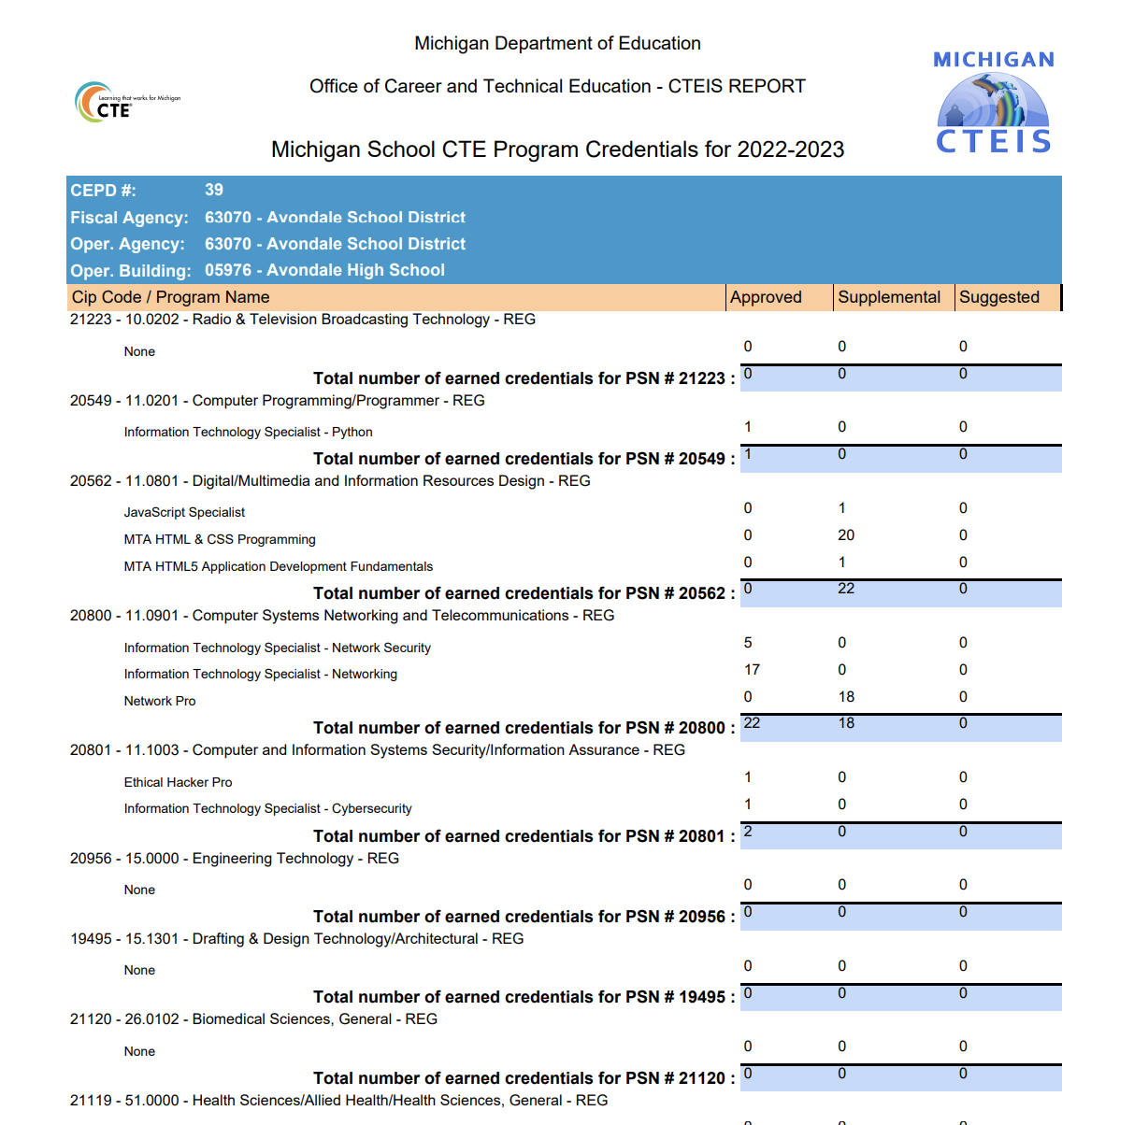
Credentials by PSN
Manage Credentials
CTEIS.COM (requires login)
Available for your assigned buildings
By Building, lists
  Credentials provided in the selected year
  Counts of
    Approved
    Supplemental
    Suggested

Slide 10
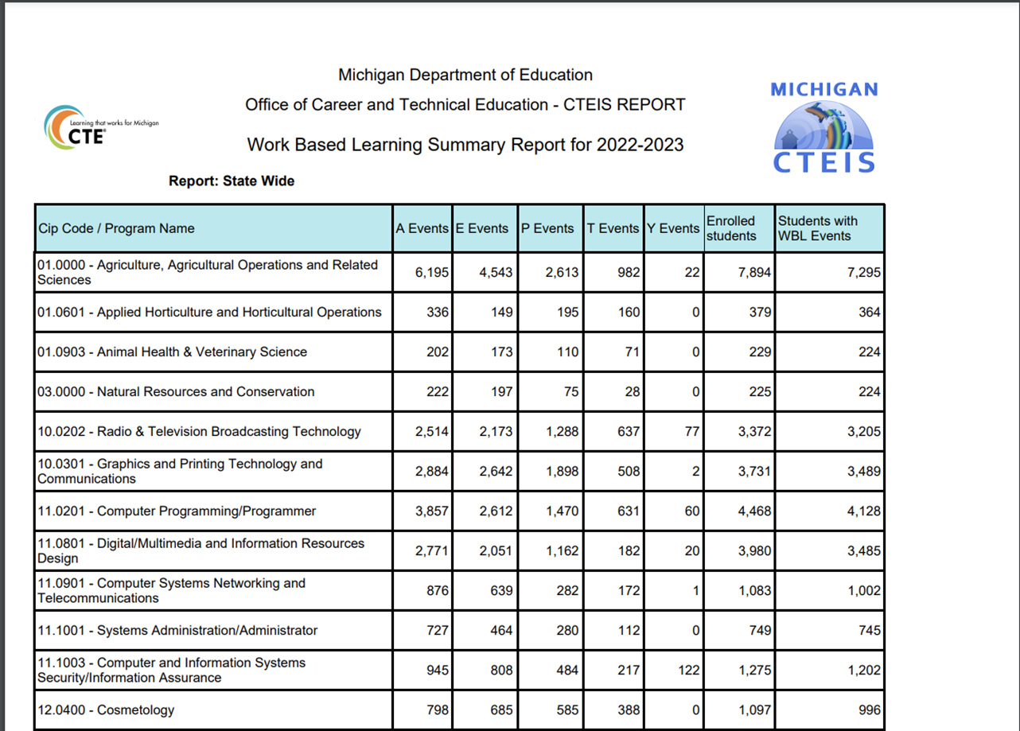
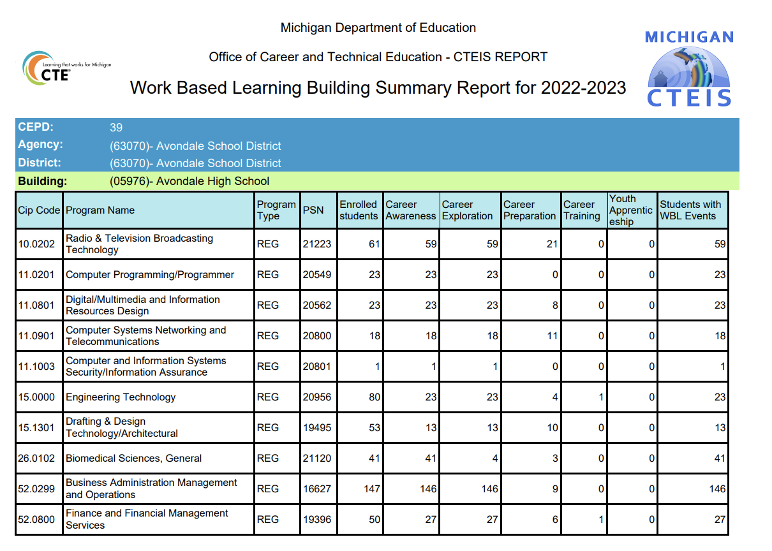
Work based learning Reports review
Work Based Learning
REPORTS.CTEIS.COM
  Work Based Learning Summary Report
District CTEIS.com
  Work Based Learning Summary by Building

Slide 11
2023 CTEIS Updates
  Enrollments
    Manage Enrollments Update
    Minimal Import Update
    Mange Students Update
      Migrant Students
    CEPD Admin Building Enrollment Report
    Class List Report
  Expenditures
    X0207 Report

Slide 12
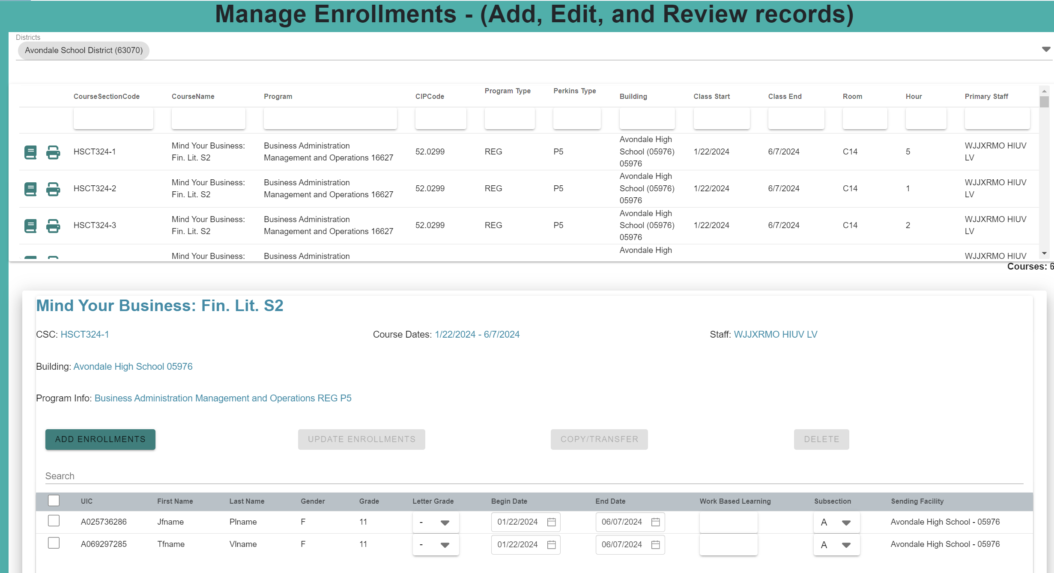
2023 CTEIS Updates
Manage Enrollments
Manage Enrollments Update
  Faster
  Easier to use
  Inline edits of enrollments

Slide 13
2023 CTEIS Updates
Manage Enrollments
Minimal Import Update
  Requires
    UIC
    Last name
    Course Section Code
    Building
    Grade/WBL
  Requires
    Enrollment record already exists
      Student
      Course
      Enrollment

Slide 14
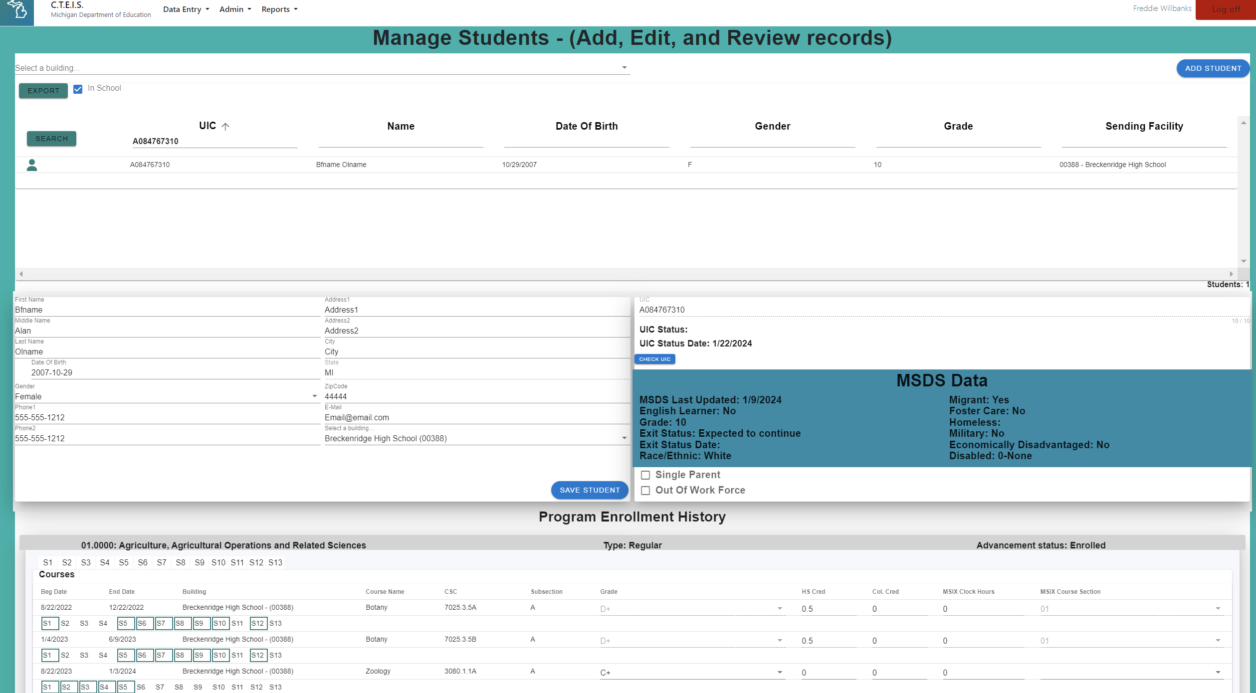
2023 CTEIS Updates
Manage Enrollments
Mange Students Update
  Migrant Students

Slide 15
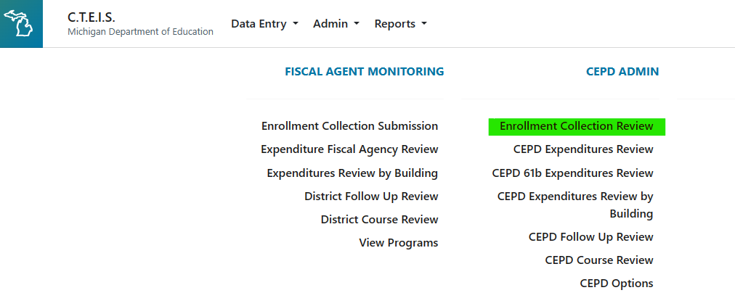
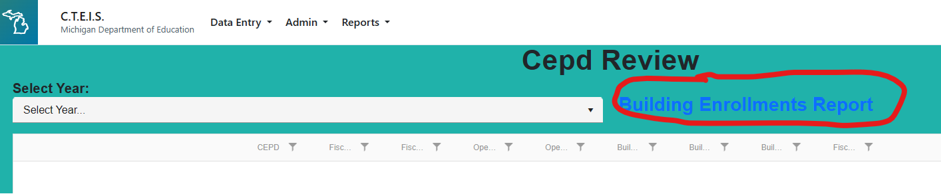
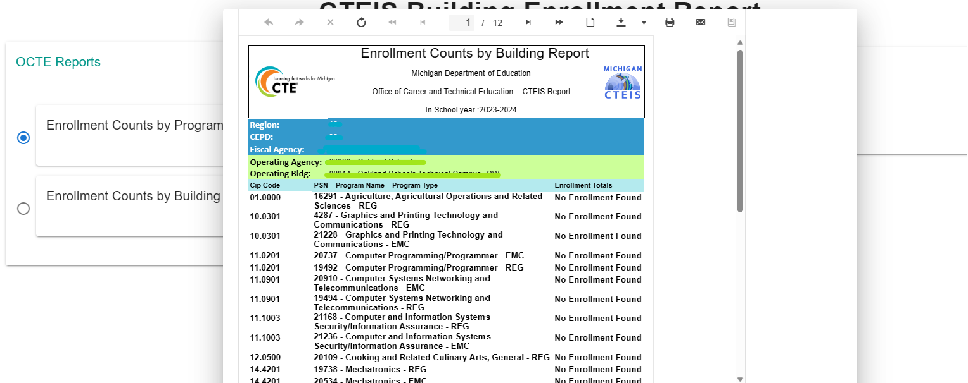
2023 CTEIS Updates
Manage Enrollments
CEPD Admins
  Enrollment Collection Review
    Building Enrollment Reports

Slide 16
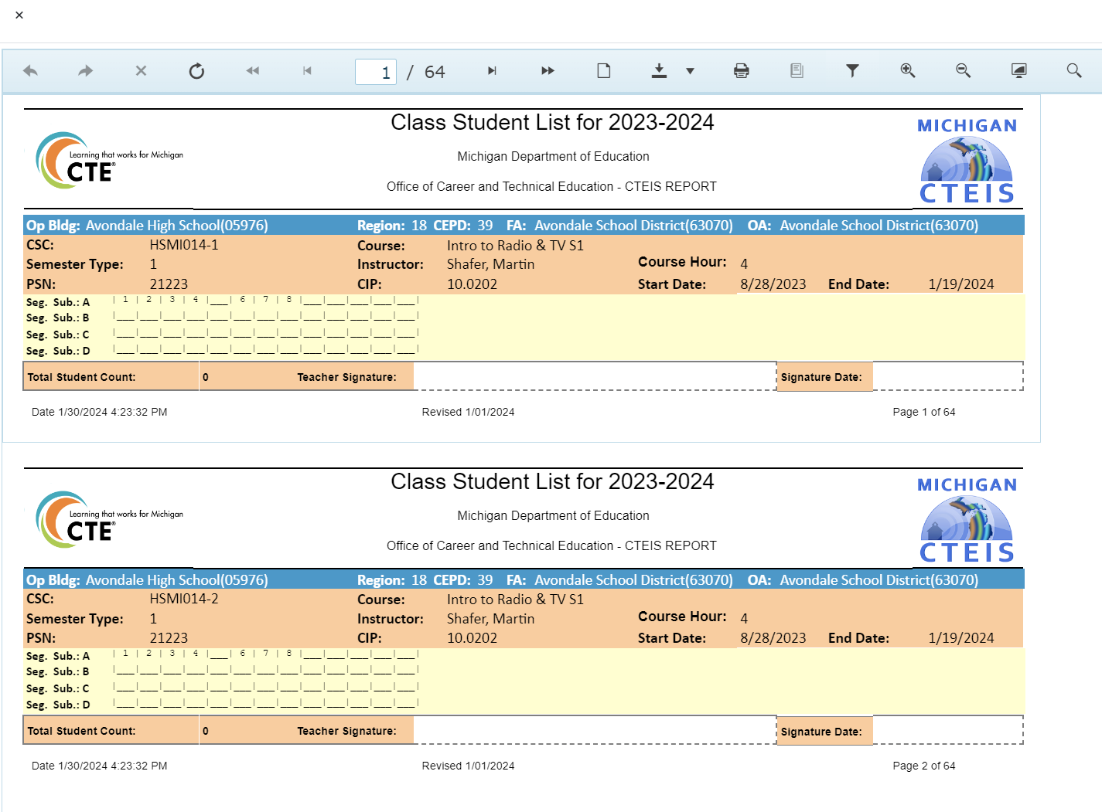
2023 CTEIS Updates
Manage Enrollments
Class List Report
  Shows segs/comps for empty classes

Slide 17
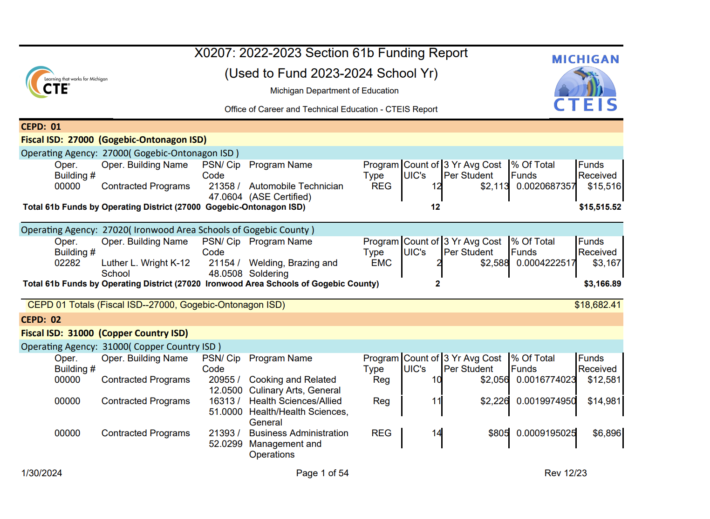
2023 CTEIS Updates
Manage Expenditures
  Expenditures
    X0207 Report

Slide 18
Upcoming dates
EOY Completion Entry
EMC and Dual Enrollment Extraction
Work Based Learning
  Due to CEPD: Jun. 13, 2024
  Due to OCTE: Jun. 20, 2024
Credentials
  Preliminary reporting Due to CEPD: Jun. 13, 2024
  Preliminary reporting Due to OCTE: Jun. 20, 2024
  Final reporting Due to OCTE: Aug. 31, 2024
Administrators
CEPD Options
  Due June 6, 2024
Count Days
  Fall: Oct. 4, 2023
  Spring: Feb. 14, 2024
***May 12, 2024 - Final student enrollment deadline (must include correct UICs)

Slide 19
Upcoming training
Spring Enrollment Training
CTEIS Spring Tasks:
March 12, 2024
March 14, 2024
Completing CTEIS Enrollment Collection:
April 16, 2024
April 18, 2024
April 23, 2024
April 25,
April 30, 2024
May 2, 2024
Completing Spring Enrollment e-Workshop:
June 11, 2024
Fiscal Agent Training
May 29, 2024
CEPD Administrator Training
May 29, 2024

Slide 20
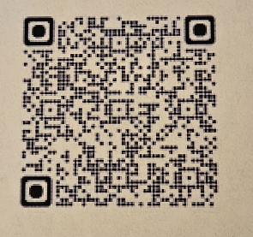
Thank You! Questions?
Doug Wiesner, Ph.D.
PTD Technology
Doug.Wiesner@PTDTechnology.com
CTEIS.Help@PTDTechnology.com
Check out our Knowledge Base at
http://support.cteis.com
This slide deck will be available on SUPPORT.CTEIS.com shortly
SCECHS

